Slide 1
MACHINE LEARNING
Lecture 4

Slide 2
Agenda
Optimization algorithms
Gradient Ascent and Descent
Stochastic Gradient Descent
The sigmoid function
The logistic regression classifier

Slide 3
Example of Optimization
How do we get from point A to point B in the least amount of time?
How do we make the most money doing the least amount of work?
How do we design an engine to produce the most horsepower while using the least amount of fuel?

Slide 4

Using optimization to find the best regression coefficients
The input to the sigmoid function described will be z, where z is given by the following:
In vector notation we can write this as

Slide 5

Calculus in Optimization
Consider function y=f (x), x, y real nos
Derivative of function denoted: f’(x) or as dy/dx
It specifies how to scale a small change in input to obtain a corresponding change in the output:

Slide 6
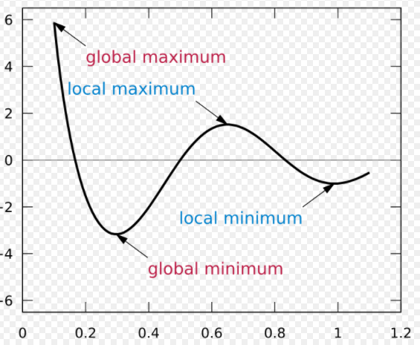

Slide 7
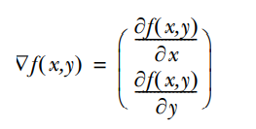
Gradient ascent:
The first optimization algorithm we’re going to look at is called gradient ascent.
Gradient ascent is based on the idea that if we want to find the maximum point on a function, then the best way to move is in the direction of the gradient (greatest increase) .

Slide 8
Gradient Decent:
Gradient descent is an optimization algorithm used to find the values of parameters (coefficients) of a function (f) that minimizes a cost function (cost). Gradient descent is best used when the parameters cannot be calculated analytically (e.g. using linear algebra) and must be searched for by an optimization algorithm.

Slide 9
Gradient Descent Procedure
The procedure starts off with initial values for the coefficient or coefficients for the function. These could be 0.0 or a small random value.
coefficient = 0.0
The cost of the coefficients is evaluated by plugging them into the function and calculating the cost.
cost = f(coefficient) cost = evaluate(f(coefficient))

Slide 10
Gradient Descent Procedure
The derivative of the cost is calculated. The derivative is a concept from calculus and refers to the slope of the function at a given point.
We need to know the slope so that we know the direction (sign) to move the coefficient values in order to get a lower cost on the next iteration
delta = derivative(cost)
This process is repeated until the cost of the coefficients (cost) is 0.0 or no further improvements in cost can be achieved

Slide 11
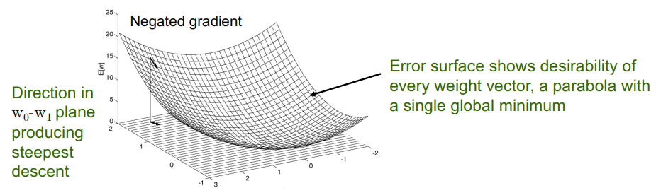
Application in ML: Minimize Error
Gradient descent search determines a weight vector w that minimizes E(w) by
– Starting with an arbitrary initial weight vector
– Repeatedly modifying it in small steps
– At each step, weight vector is modified in the direction that produces the steepest descent along the error surface

Slide 12
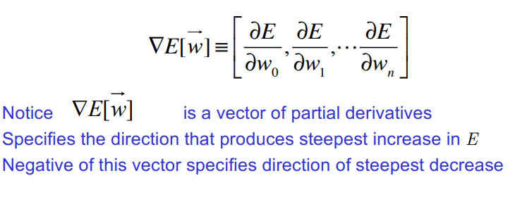
Definition of Gradient Vector
The Gradient (derivative) of E with respect to each component of the vector w

Slide 13


Example
Linear Regression and MSE
L(w) =
Optimization problem:

Slide 14
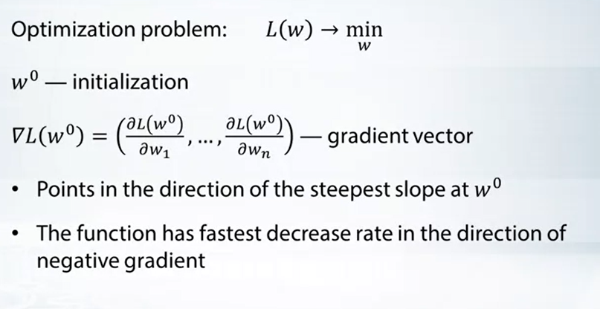
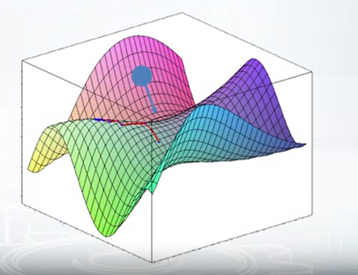
How Do We Optimize This?

Slide 15
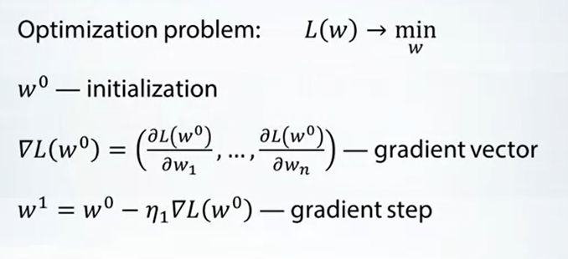
Gradient Descent

Slide 16
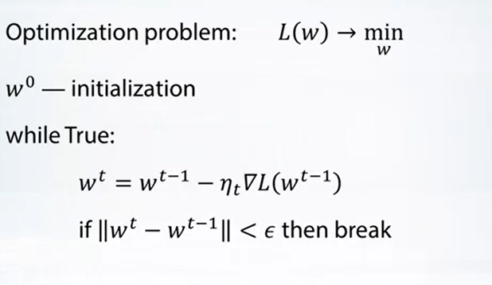
Gradient Descent

Slide 17
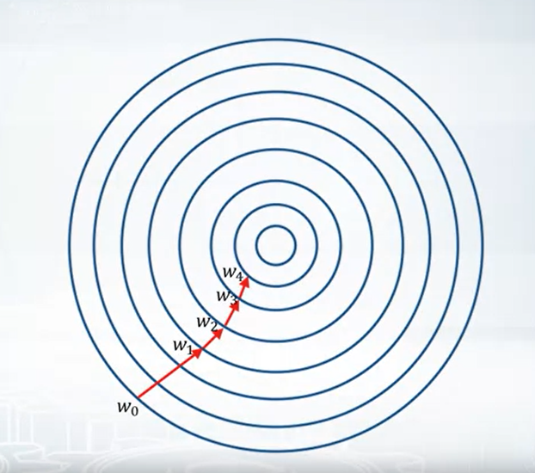

Slide 18
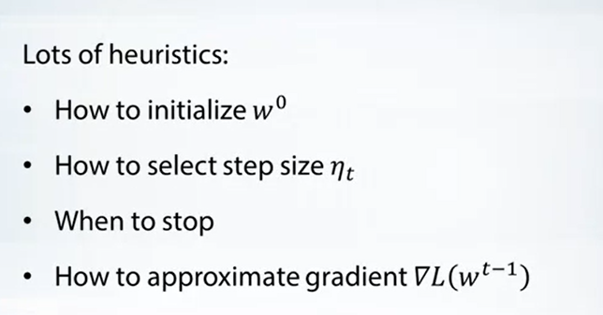
Gradient Descent

Slide 19
Stochastic Gradient Descent
Gradient descent can be slow to run on very large datasets. Because one iteration of the gradient descent algorithm requires a prediction for each instance in the training dataset, it can take a long time when you have many millions of instances.
In situations when you have large amounts of data, you can use a variation of gradient descent called stochastic gradient descent. In this variation, the gradient descent procedure described above is run but the update to the coefficients is performed for each training instance, rather than at the end of the batch of instances.

Slide 20
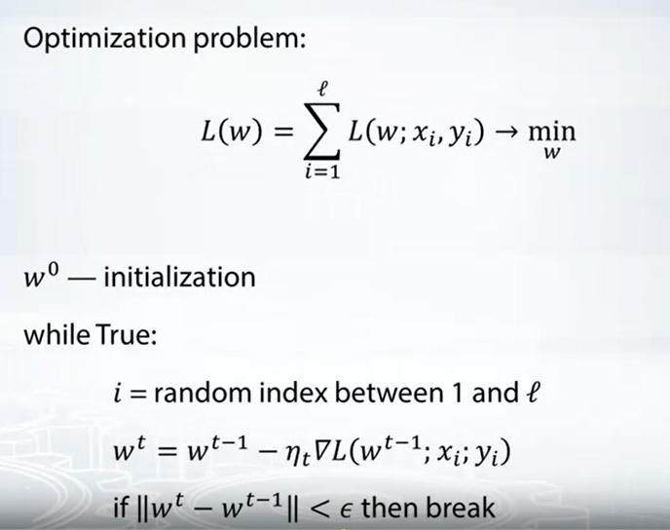
Stochastic Gradient Descent

Slide 21
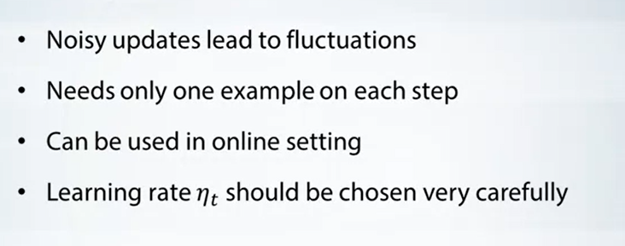
Stochastic Gradient Descent

